Slide 1
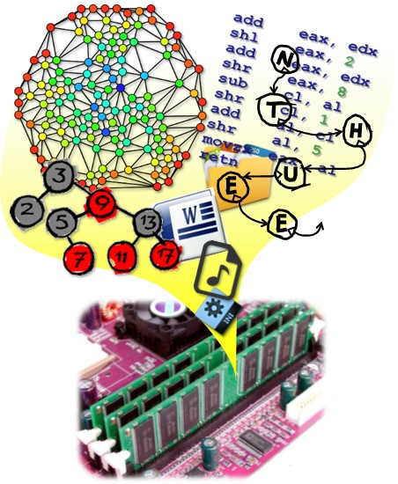
Data Structures
CH4 Linked Lists
Prof. Tai-Lang Jong
Office: Delta 928
Tel: 42577
email: tljong@mx.nthu.edu.tw
Spring 2021

Slide 2
Outline
4.1 Singly Linked Lists & Chains
4.2 Representing Chains in C++
4.3 The Template Class Chain
4.4-4.5 Circular Lists & Available Space Lists
4.6 Linked Stacks & Queues
4.7 Polynomials,
4.8 Equivalent Classes
4.9 Sparse Matrices
4.10 Doubly Linked Lists
4.11 Generalized Lists

Slide 3
Linear List
Linear (ordered) list:
Mathematical model : L = (a₀, a₁, …., a_{n})
Linear list ADT:
Retrieve
Store
Insert
Delete
….
Implementation of ordered list
Array + sequential mapping – sequential list
Linked list – nonsequential representation
a
b
c
d
e

Slide 4
Sequential Representation of a List
Retrieve, Store -- O(1), but Insert, Delete – O(n)
Insertion and deletion of arbitrary elements cause excessive data movement
list of three-letter words ending in AT
0
BAT
0
BAT
0
BAT
1
CAT
Move data
1
CAT
1
CAT
2
EAT
2
2
DAT
Insert "DAT"
3
FAT
3
EAT
3
EAT
4
HAT
4
FAT
4
FAT
5
JAT
5
HAT
5
HAT
6
6
JAT
6
JAT

Slide 5
Sequential Representation of a List
Insertion and deletion of arbitrary elements cause excessive data movement
list of three-letter words ending in AT
0
BAT
0
BAT
0
BAT
1
CAT
1
CAT
Move data
1
CAT
2
DAT
Delete "DAT"
2
2
EAT
3
EAT
3
EAT
3
FAT
4
FAT
4
FAT
4
HAT
5
HAT
5
HAT
5
JAT
6
JAT
6
JAT
6

Slide 6
Nonsequential List Representation
A solution to excessive data movement problem – using linked (nonsequential) list representation
data
link
1 | HAT
2
3 | CAT
4 | EAT
5
6 | WAT
7 | BAT
8 | FAT
9
1 | 15
2
3 | 4
4 | 8
5
6 | 0
7 | 3
8 | 1
9
Node

Slide 7
Linked Lists
List elements are stored, in memory, in an arbitrary order (nonsequential order)
Explicit information (called a link) is used to go from one element to the next
c
a
e
d
b
c
a
e
d
b
pointer (or link) in e is NULL
use a variable first to get to the first element a
first

Slide 8
Usual Way to Draw a Linked List (1)
first
Node
BAT
CAT
EAT
…
WAT
0
a
Data
Pointer
struct Node
{
int data;
Node* link;
};
class Node
{ private:
int data;
Node* link;
};
Node a, * first;
a.data = “BAT”;
a.link = …;
first = &a;
Node * first = new Node;

Slide 9
Usual Way to Draw A Linked List (2)
first
NULL
a
b
c
d
e
link or pointer field of node
data field of node

Slide 10
Insert Steps
FAT
HAT
To insert the data item GAT between FAT and HAT:
Get a node a that is currently unused
a = unused node or Node* a = new Node
Set the data field of a to GAT
a.data = GAT or a->data = GAT
Set the link field of a to point to the node after FAT, which contains HAT: get node(FAT)
a.link = node(FAT).link or a->link = node(FAT)->link
Set the link field of the node containing FAT to a
node(FAT).link = &a or node(FAT)->link = a

Slide 11
Linked Representation of a List
Insertion of arbitrary elements are simplified
Index denoting the next element
0
BAT
1
0
BAT
1
0
BAT
1
1
CAT
2
1
CAT
2
1
CAT
2
Adjust
indices
2
EAT
3
2
EAT
3
2
EAT
3
3
FAT
4
3
FAT
4
3
FAT
6
4
HAT
5
4
HAT
5
4
HAT
5
5
JAT
0
5
JAT
0
5
JAT
0
6
6
GAT
6
GAT
4
Insert “GAT"
No data movement!

Slide 12
Singly Linked List (Chain)
Insertion
Node
BAT
CAT
FAT
HAT
JAT
first
Data
Pointer
BAT
CAT
FAT
HAT
JAT
first
GAT

Slide 13
Linked Representation of a List
Deletion of arbitrary elements are simplified too
Index denoting the next element
0
BAT
1
0
BAT
1
0
BAT
1
1
CAT
2
1
CAT
2
Adjust
indices
1
CAT
2
2
EAT
3
2
EAT
3
2
EAT
3
3
FAT
6
3
FAT
4
3
FAT
4
4
HAT
5
4
HAT
5
4
HAT
5
5
JAT
0
5
JAT
0
5
JAT
0
6
GAT
4
6
GAT
4
6
Delete “GAT"
No data movement!

Slide 14
Singly Linked List (Chain)
Deletion of GAT
Node
BAT
CAT
FAT
GAT
HAT
first
Data
Pointer
BAT
CAT
FAT
GAT
HAT
first

Slide 15
Chain
first
NULL
a
b
c
d
e
A chain is a linked list in which each node represents one element
There is a link or pointer from one element to the next
The last node has a NULL (or 0) pointer

Slide 16
Pros and Cons of Linked List
Advantages:
Insertion & deletion are easier than sequential (array) list
With large records, moving pointer is easier and faster than moving the data items themselves
Linked list can grow one node by one node as needed, which is faster than dynamic array resizing.
Disadvantages
The pointer (link) requires extra space
Linked lists do not allow random access
Traversing and changing pointer take times
Programming is typically trickier with pointers

Slide 17
Outline
4.1 Singly Linked Lists & Chains
4.2 Representing Chains in C++
4.3 The Template Class Chain
4.4-4.5 Circular Lists & Available Space Lists
4.6 Linked Stacks & Queues
4.7 Polynomials,
4.8 Equivalent Classes
4.9 Sparse Matrices
4.10 Doubly Linked Lists
4.11 Generalized Lists

Slide 18
Representing a List Node in C++
class ThreeLetterNode {
private:
char data[3];
ThreeLetterNode * link;
};
data
link
class ThreeLetterNode {
public:
char data[3];
ThreeLetterNode * link;
};
link
data
struct ThreeLetterNode {
char data[3];
ThreeLetterNode * link;
};

Slide 19
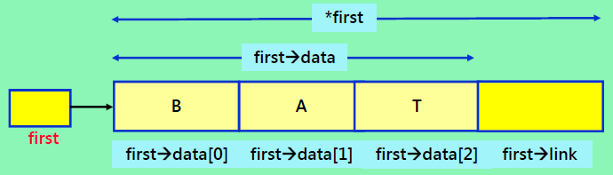
Representing a Chain in C++ (1/5)
Design Attempt 1: (use class ThreeLetterNode)
Use a global variable first which is a pointer of ThreeLetterNode. (ThreeLetterNode *first;)
Unable to access to private data members directly
class ThreeLetterNode {
private:
char data[3];
ThreeLetterNode *link;
};
main(){
…
ThreeLetterNode *first;
first -> link = xxx;
}

Slide 20
Representing a Chain in C++ (2/5)
Design Attempt 1: (cont.)
Remedy :
Change data members to public == give up data encapsulation, equivalent to C struct
Using struct is a popular approach in C
Provide public accessor and mutator member functions – tedious and not data encapsulation
Use composite classes or nested classes (allow only the linked list object to access private ThreeLetterNode data, not any other objects)

Slide 21
Representing Chains in C++ (3/5)
Design Attempt 2:
Make data members public
Allow one to access the data through pointer first, but
Defeat the purpose of data encapsulation:
We should not know how the list is implemented
Define public accessor, mutator member functions: GetLink(), SetLink() and GetData(), SetData()
The access is less efficient
The ideal solution:
Only grant those functions that perform list manipulation operations (i.e., inserting a node or deleting a node) access to the (private) data members of ThreeLetterNode

Slide 22
Chain of Three-Letter Words (C struct Style)
struct ThreeLetterNode{
char data[3];
ThreeLetterNode *link;
};
ThreeLeterNode a;
a.data[0] = ‘B’;
a.data[0] = ‘A’;
a.data[0] = ‘T’;
a.link = 0; //null pointer
ThreeLeterNode *first = &a;
ThreeLeterNode *first;
first = new ThreeLeterNode;
first->data[0] = ‘B’;
first->data[0] = ‘A’;
first->data[0] = ‘T’;
first->link = 0;
*first
first->data
first->link
first->data[2]
first->data[1]
first->data[0]

Slide 23
Representing Chains in C++ (4/5)
Design Attempt 3:
Use composite of two classes.
Create a class (ThreeLetterChain) that represents the linked list, which provides member functions for performing list manipulations.
The objects of this class (ThreeLetterChain) consists of zero or more objects of the other class (ThreeLetterNode) – HAS-A relationship.

Slide 24
HAS-A relationship
A data object of Type A HAS-A data object of Type B if A conceptually contains B or B is a part of A, e.g.,
Computer HAS-A Processor
Book HAS-A page
HAS-A relationship between ADTs are usually expressed by making the contained class a member of the containing class

Slide 25
Chain of Three-Letter Words (Composite Class Style)
class ThreeLetterChain; // forward declaration
class ThreeLetterNode {
friend class ThreeLetterChain;
private:
char data[3];
ThreeLetterNode *link;
};
class ThreeLetterChain {
public:
// chain manipulation operations
…
private:
ThreeLetterNode *first;
};
List
ListNode

Slide 26
Representing Chains in C++ (5/5)
An alternative method to represent a chain in C++ is to use nested classes, where one class is defined inside the definition of another class.
Here class ThreeLetterNode is defined inside the private portion of the definition of class ThreeLetterChain.
Chain (List) class:
Composite style:
Use friend to provide direct access of Node private data members
Nested class style:
Node data members declared public

Slide 27
Chain of Three-Letter Words (Nested Class Style)
class ThreeLetterChain {
public:
// chain manipulation operations
…
private:
class ThreeLetterNode {//nested
public:
char data[3];
ThreeLetterNode *link;
};
ThreeLetterNode *first;
};
*first
first->data
first->link
first->data[2]
first->data[1]
first->data[0]

Slide 28
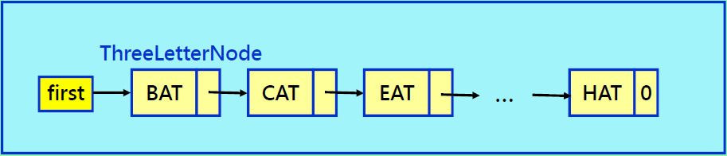
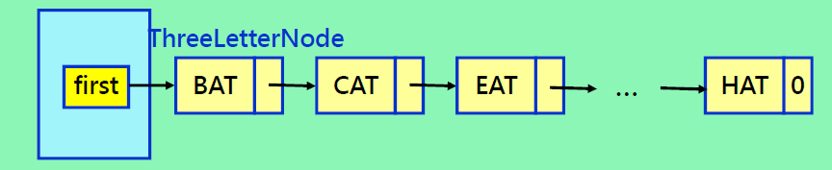
Relationship of List and Node
ThreeLetterChain
Conceptual relationship
ThreeLetterChain
Actual relationship

Slide 29
Pointer Manipulation Example
ThreeLetterNode * x;
ThreeLetterNode * y;
x = new ThreeLetterNode;
y = new ThreeLetterNode;
y->data[0] = 'B';
y->data[1] = 'A';
y->data[2] = 'T';
y->link = x;
*x = *y;
x = y;
x = y->link;
delete x;
delete y;
x
y
x
y
B
A
T
x
B
A
T
y
B
A
T
(For exampling purpose only)
x
B
A
T
y
B
A
T
x
y

Slide 30
Example: Chain of Integers in C++
class Chain; // forward declaration
class ChainNode {
friend class Chain;
public:
ChainNode (int element = 0, ChainNode* next = 0)
:data(element),link(next) { }//default constructor
private:
int data;
ChainNode *link;
};
class Chain
{
public:
Chain(){first = 0;}//default constructor
// chain manipulation operations
…
private:
ChainNode *first;
}

Slide 31
Chain Manipulation Operations
Example 4.2: Create a chain with two nodes
void Chain::Create2()
{
// create and set fields of second node
ChainNode* second = new ChainNode(20, 0);
// create and set fields of first node
first = new ChainNode(10, second);
}
second
first
10
20
0

Slide 32
Chain Manipulation Operations
Example 4.3: Insert a node with value 50 after node x
void Chain::Insert50(ChainNode* x)
{
if(first == 0) // insert into an empty chain
first = new ChainNode(50);
else // x is the inserting point
x->link = new ChainNode(50, x->link);
}
first
first
50
0
10
20
0
x
50
empty case
non-empty case

Slide 33
Chain Manipulation Operations
Exp 4.4: Delete/remove a node toDel w. its pevious
void Chain::Delete(ChainNode* toDel, ChainNode* prev)
{
if(toDel == first)
first = first->link;
else
prev->link = toDel->link;
delete toDel;
}
first
prev
toDel
deleting first case
deleting others case

Slide 34
Outline
4.1 Singly Linked Lists & Chains
4.2 Representing Chains in C++
4.3 The Template Class Chain
4.4-4.5 Circular Lists & Available Space Lists
4.6 Linked Stacks & Queues
4.7 Polynomials,
4.8 Equivalent Classes
4.9 Sparse Matrices
4.10 Doubly Linked Lists
4.11 Generalized Lists

Slide 35
Template Class Chain
It is a waste of time for programmers to develop different types of chains and their associated algorithms over and over
Three-letter word chain
Integer chain
…
It is desirable for programmers to have a reusable chain class
Template and iterators can help

Slide 36
Template Node Representation
template <class T>
class ChainNode
{
public:
// constructors come here
private:
T data;
ChainNode<T> *link;
};

Slide 37
Constructors of ChainNode
?
ChainNode() { }
?
ChainNode( const T& data)
{this->data = data;}
?
data
ChainNode(const T& data, chainNode<T>* link) {
this->data = data;
this->link = link;
}
link
data

Slide 38
Template Class Chain
template <class T> class Chain; // forward declaration
template <class T>
class ChainNode {
friend class Chain <T>;
private:
T data;
ChainNode<T>* link;
};
template <class T>
class Chain {
public:
Chain( ) {first = 0;} // constructor
~Chain( ); // destructor
bool IsEmpty() {return first==0;}
// Chain manipulation operations
private:
ChainNode<T>* first;
};
Usage:
Chain<char> c_list;
Chain<int> i_list;
Chain<float> f_list;
Chain<Rectangle> r_list;
…

Slide 39
The Destructor
template<class T>
chain<T>::~chain()
{// Chain destructor. Delete all nodes
// in chain.
while (first != NULL)
{// delete first
ChainNode<T>* next = first->link;
delete first;
first = next;
}
}

Slide 40
Get(0)
Get element of the first node (list element at index 0)
first
NULL
a
b
c
d
e
ChainNode * desiredNode;
desiredNode = first; //gets you to first node
return desiredNode->data;

Slide 41
Get(1)
Get element of the second node (at list index 1)
first
NULL
a
b
c
d
e
ChainNode * desiredNode;
desiredNode = first->link;
//gets you to the second node
return desiredNode->data;

Slide 42
Get(2)
Get element of the third node (at list index 2)
first
NULL
a
b
c
d
e
ChainNode * desiredNode;
desiredNode = first->link->link;
//gets you to the third node
return desiredNode->data;

Slide 43
Get(5)
Get element of the sixth node (at list index 5)
first
NULL
a
b
c
d
e
ChainNode * desiredNode;
desiredNode = first->link->link->link->link->link;
//gets you to the sixth node: NULL
return desiredNode->data; //NULL.data

Slide 44
The Method IndexOf
template<class T>
int Chain<T>::IndexOf(const T& theElement) const
{ // search the chain for theElement
ChainNode<T>* currentNode = first;
int index = 0; // index of currentNode
while(currentNode !=NULL && currentNode->data != theElement)
{ // move to next node
currentNode = currentNode->next;
index++;
}
// make sure we found matching element
if (currentNode == NULL)
return -1;
else
return index;
}

Slide 45
Delete An Element (≡ Del a Node)
Delete(0)
Delete element of the first node (at list index 0)
first
NULL
a
b
c
d
e
ChainNode * deletedNode;
deletedNode = first; //gets you to first node
first = first->link;
delete deleteNode; //delete the first node

Slide 46
Delete(2) (1/3)
Delete element of the third node (at list index 2)
first
NULL
a
b
c
d
e
beforeNode
1. first get to node just before node to be removed
ChainNode * beforeNode;
beforeNode = first->link;

Slide 47
Delete(2) (2/3)
Delete element of the third node (at list index 2)
first
NULL
a
b
c
d
e
beforeNode
deleteNode
2. save pointer to node that will be deleted
deleteNode = beforeNode −>link;

Slide 48
Delete(2) (3/3)
Delete element of the third node (at list index 2)
first
NULL
a
b
c
d
e
beforeNode
deleteNode
3. now change pointer in beforeNode
beforeNode->link = beforeNode->link->link;
delete deleteNode; //return mem. to free store

Slide 49
Delete An Element (1/2)
template<class T>
void Chain<T>::Delete(int theIndex)
{
if (first == 0)
throw “Cannot delete from empty chain”;
ChainNode<T>* deleteNode;
if (theIndex == 0)
{// remove first node from chain
deleteNode = first;
first = first->link;
}

Slide 50
Delete An Element (2/2)
else
{ // use p to get to beforeNode
ChainNode<T>* p = first;
for (int i = 0; i < theIndex - 1; i++)
{
if (p == 0)
throw “Delete element does not exist”;
p = p->next;
}
deleteNode = p->link;
p->link = p->link->link;
}
delete deleteNode;
}

Slide 51
Insert(0,’f’) (1/2)
Insert element of the first node (at list index 0)
first
NULL
f
a
b
c
d
e
newNode
Step 1: get a node, set its data and link fields
newNode = new ChainNode<char>(theElement, first);

Slide 52
Insert(0,’f’) (2/2)
Insert element of the first node (at list index 0)
first
NULL
f
a
b
c
d
e
newNode
Step 2: update first
first = newNode;

Slide 53
One-Step Insert(0,’f’)
Insert element of the first node (at list index 0)
first
NULL
f
a
b
c
d
e
newNode
first = new chainNode<char>(‘f’, first);

Slide 54
Insert(3,’f’)
Insert element at the fourth node (at list index 3)
first
newNode
f
c
NULL
a
b
c
d
e
beforeNode
first find node whose index is 2
next create a node and set its data and link fields
ChainNode<char>* newNode = new ChainNode<char>( ‘f’, beforeNode->link);
finally link beforeNode to newNode
beforeNode -> link = newNode;

Slide 55
Two-Step Insert(3,’f’)
first
newNode
f
c
NULL
a
b
c
d
e
beforeNode
beforeNode = first->link->link;
beforeNode->link = new ChainNode<char>
(‘f’, beforeNode->link);

Slide 56
Insert An Element (1/2)
template<class T>
void Chain<T>::Insert(int theIndex,const T& theElement)
{
if (theIndex < 0)
throw “Bad insert index”;
if (theIndex == 0)
// insert at front
first = new chainNode<T> (theElement, first);

Slide 57
Insert An Element (2/2)
else
{ // find predecessor of new element
ChainNode<T>* p = first;
for (int i = 0; i < theIndex - 1; i++)
{
if (p == 0)
throw “Bad insert index”;
p = p->next;
}
// insert after p
p->link = new ChainNode<T>(theElement, p->link);
}
}

Slide 58
Motivation of Chain Iterators (1/5)
Consider the following tasks for a container C containing integers
Print out all integers in C
Find the max, min, median, or mean of all integers in C
Find the sum, product, or sum of squares of all integers in C
Obtain all integers in C that satisfy some property P (e.g., P could be is a positive integer, is a square of an integer, etc.)
Find an integer x in C that maximizes some function f(x)
All these require us to examine all elements of the container – traversal of the container, e.g.,
for each item in C; // C is a container

Slide 59
Motivation of Chain Iterators (2/5)
Pseudo code for those tasks:
E.g., to find the maximum of all elements in C:
Initialization step;
for each item in C // C is a container
{
k = current item of C;
do something with k;
}
Postprocessing step;
1 int x = std::numeric_limits<int>::min(); //#include <limit>
2 for each item in C
3 {
4 k = current item in C;
5 x = max(k,x);
6 }
7 return x;

Slide 60
Motivation of Chain Iterators (3/5)
First drawback of the naïve approach: implementation of the task is container-dependent
For an array list a[n]
For a nonempty chain of integers (linked list)
2 for(int i = 0; i < n; i++)
4 k = a[i];
2 for(ChainNode<int>* ptr = first; ptr != 0; ptr = ptr->link)
4 k = ptr->data;

Slide 61
Motivation of Chain Iterators (4/5)
Second drawback of the naïve approach : operations need to be member functions of the particular container class as they access private data. However,
Not all operations are meaningful for all classes
e.g., sum is meaningful for Chain<int> but not for Chain<Rectangle>
Number of member functions can become large. Infeasible for the class designer to predict all the operations
Even if acceptable for the user to add member function, class users would have to learn how the container class is implemented when they want to add member function

Slide 62
Motivation of Chain Iterators (5/5)
These arguments suggest that container classes be equipped with iterators that provide systematic access to the elements of the object.
An iterator permits you to examine the elements of a data structure one at a time.
Users can employ these iterators to implement their own functions depending upon the particular application.
Typically, an iterator is implemented as a nested class of the container class. (or a friend class)

Slide 63
Iterators
Iterator is an object type that mimics pointers (a pointer to an element of an (container) object, e.g., a pointer to an element of an array or chain)
Typically, a nested class of a container class
Designed to systematically access the elements of a container class one by one
User can employ iterators to implement their own functions
void main(){
int x[3] = {0,1,2};
for (int* y=x; y!=x+3; y++)
cout << *y << “ “;
cout << endl;
}
for (int i=0; i!=3; i++)
cout << x[i] << “ “;
for(Iterator i=start; i!=end; i++)
cout << *i << “ “;

Slide 64
C++ Iterators
……
start
end
for(Iterator i=start; i!=end; i++)
cout << *i << “ “;
Iterator is the data type of the iterator, start is the iterator value for the first element in the range [start,end) and end is the value the iterator has when incremented one past the last element
The concept of an iterator is fundamental to writing generic code in C++
Design philosophy
Implementing iterators is tedious for designers –- C++ STL provide iterator for STL containers
Users' jobs are simplified

Slide 65
Possible Code for STL copy Function
Template <class Iterator>
void copy(Iterator start, Iterator end, Iterator to)
{ // copy from [start,end) to [to, to + end - start)
while (start != end)
{
*to = *start;
start++; to++;
}
}
This code maybe used to copy elements of any object that has an iterator for which the operators != and ++ (postincrement) as well as the dereferencing operator (*) have been defined.

Slide 66
C++ Iterators
Support pointer-like operations
Using operator overloading
C++ provides iterators which are classified into five categories according to the supported operations
Input iterators: support read access to the elements pointed at and ++
Output iterators: support write access to the elements pointed at and ++
Forward iterators: support both input and output
Bidirectional iterators: additionally support --
Random access iterators: additionally support jumps by arbitrary amounts
input
output
forward
bidirectional
Random access

Slide 67
Forward Iterator
Allows only forward movement through the elements of a data structure
Support both input and output
Forward Iterator Methods:
iterator(T* thePosition)
Constructs an iterator positioned at specified element
Dereferencing operators * and ->
Post and pre increment operators ++
Equality testing operators == and !=

Slide 68
Bidirectional Iterator
Allows both forward and backward movement through the elements of a data structure
Support both input and output
Bidirectional Iterator Methods:
iterator(T* thePosition)
Constructs an iterator positioned at specified element
Dereferencing operators * and ->
Post and pre increment and decrement operators ++ and --
Equality testing operators == and !=

Slide 69
Iterator Class
Assume that a forward iterator class ChainIterator is defined within the class Chain
Assume that methods begin() and end() are defined for Chain
begin() returns an iterator positioned at element 0 (i.e., leftmost node) of list.
end() returns an iterator positioned one past last element of list (i.e., NULL or 0).

Slide 70
Using an Iterator
Chain<int>::iterator xHere = x.begin();
Chain<int>::iterator xEnd = x.end();
for (; xHere != xEnd; xHere++)
examine( *xHere);
vs
for (int i = 0; i < x.Size(); i++)
examine(x.Get(i));

Slide 71
Merits of an Iterator
It is often possible to implement the ++ and -- operators so that their complexity is less than that of Get(i).
This is true for a chain
Many data structures do not have a get by index method
Iterators provide a uniform way to sequence through the elements of a data structure

Slide 72
A Forward Iterator for Chain
Template <class T>
class ChainIterator {
public:
// some typedefs omitted
// constructor comes here
// dereferencing operators * & ->
// pre and post increment
// equality, inequality testing operators
// and more functions…
private:
ChainNode<T> *current;
};

Slide 73
class ChainIterator{
public: //typedefs required by C++ for a forward iterator
//Constructor
ChainIterator(ChainNode<T>* startNode = 0)
{current = startNode;}
//Dereferencing operators
T& operator *() const {return current -> data;}
T* operator ->() const {return &current -> data;}
//Increment
ChainIterator& operator ++() //preincrement
{current = current ->link; return *this;}
ChainIterator& operator ++(int) //postincrement
{ChainIterator old = *this;
current = current ->link; return old;}
//Equality test
bool operator!=(const ChainIterator r)
{return current != r.current;}
bool operator==(const ChainIterator r)
{return current == r.current;}
private: ChainNode <T> * current;
};

Slide 74
class ChainIterator{
public:
//More functions
ChainIterator begin()
{return ChainIterator(first);}
ChainIterator end()
{return ChainIterator(0);}
…..
};
Template <class T>
class Chain{
friend class ChainIterator<T>;
public:
//Chain constructor, desctructor,
…..
private:
ChainNode<T>* first;
};
Chain<int> y; Chain<int>::ChainIterator yi = y.begin();
sum = accumulate(y.begin(),y.end(),0);

Slide 75
Template <class T>
class Chain{
public:
//Chain constructor, desctructor,
class ChainIterator{
public:
…..
//More functions
ChainIterator begin()
{return ChainIterator(first);}
ChainIterator end()
{return ChainIterator(0);}
…..
};
…..
private:
ChainNode<T>* first;
};
Chain<int> y; Chain<int>::ChainIterator yi = y.begin();
sum = accumulate(y.begin(),y.end(),0);

Slide 76
Use of Iterators
Print-out function for a chain of integers
Traverse chain nodes by incrementing an iterator
Access chain nodes through dereferencing
Users do not need to directly handle chain operations
Chain<int> C;
…
for(Chain<int>::Iterator i=C.begin(); i!=C.end(); i++)
{
k = *i;
cout << k;
}

Slide 77
Combine Iterators with Template
Generic print-out function for any container with iterators
Similar to STL sort() and find(), which are also generic functions
Iterators enable us to decouple the algorithms from containers
template <class T> // T is an iterator type
void print(T begin, T end){
while(begin != end) {
cout << *begin;
begin++;
}
}

Slide 78
More Chain Operations
Design philosophy for choosing which operations to include in an object
Provide enough operations so that the class can be used in many applications
Not to include too many operations such that class Chain becomes bulky and hard to understand
Tradeoff
Example operations for a chain (linked list) object
Inserting at the back of a list
Concatenating two chains
Reversing a chain

Slide 79
Inserting at the Back of a List
template <class T>
void Chain<T>::InsertBack(const T& e)
{
if (first) { // nonempty chain
//let last points to the last node
last->link = new ChainNode<T>(e);
last = last->link;
}
else first = last = new ChainNode<T>(e);
}
0
e
x
x
e
first
0
0
0
0
0
last
first
last
last
last

Slide 80
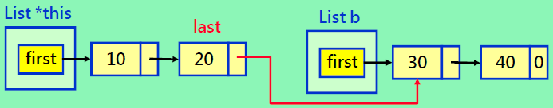
Concatenating Two Chains
template <class T>
void Chain <T>::Concatenate(Chain<T>& b)
{// b is concatenated to the end of *this
if (first) // *this is nonempty
//let last point to the last node
{last->link = b.first; last = b.last;}
else{
{first = b.first; last = b.last;}
b.first = b.last = 0; //b empty list
}

Slide 81
Reversing a Chain
prev
r
curr
r
prev
curr
template <class T>
void Chain<T>::Reverse()
{//a chain (a₁,a₂,..,a_{n}) becomes (a_{n}, a_{n-1},..,a₁)
ChainNode<T> *curr = first,
ChainNode<T> *prev = 0;
ChainNode<T> *r = 0;
while (curr) {
r = prev; // r trails prev
prev = curr; // prev trails curr
curr = curr->link; // curr moves to the next
prev->link = r; // link prev to r
}
first = prev;
}
initializing
advancing
re-linking
finalizing

Slide 82
Illustrating Reversing a Chain
Initializing
first
0
0
1
2
3
4
5
0
r
prev
curr
Advancing
first
0
1
2
3
4
5
0
r
prev
curr
Re-linking
first
0
1
0
2
3
4
5
0
r
prev
curr

Slide 83
Illustrating Reversing a Chain
Advancing
first
1
0
2
3
4
5
0
r
prev
curr
Re-linking
first
1
0
2
3
4
5
0
r
prev
curr
Advancing
+ re-linking
first
1
0
2
3
4
5
0
r
prev
curr

Slide 84
Illustrating Reversing a Chain
Advancing
+ re-linking
first
1
0
2
3
4
5
0
r
prev
curr
Advancing
+ re-linking
first
1
0
2
3
4
5
r
prev
curr
Finalizing
1
0
2
3
4
5
r
first
prev
curr

Slide 85
Summary
Create chain – constructor, first, last
Insert
InsertFirst
InsertLast
Insert(i, e)
Insert(p, e)
Delete
DeleteFirst
DeleteLast
Delete(i)
Delete(p)
Iterator – begin(), end()
Retrieve/Store(Update)
Get(i)/Set(i)
Concatenate
Reverse
0
1
2
3
4
first

Slide 86
Reusing a Class
Having designed & developed a reusable class of chain (linked list), we should try to reuse it ---polynomials.
Scenarios not to reuse a class but design a new one:
Sometimes reusing a class C1 is less efficient than directly implementing a new class C2. So if efficiency is important, better not to reuse C1.
When operations required by the application are complex and specialized, and therefore not offered by the class C1, it’s preferable to develop the application directly rather than forcing it to reuse C1.

Slide 87
Outline
4.1 Singly Linked Lists & Chains
4.2 Representing Chains in C++
4.3 The Template Class Chain
4.4-4.5 Circular Lists & Available Space Lists
4.6 Linked Stacks & Queues
4.7 Polynomials,
4.8 Equivalent Classes
4.9 Sparse Matrices
4.10 Doubly Linked Lists
4.11 Generalized Lists

Slide 88
Several Variants of Linked Lists
Circular list
last ->link = first, i.e., the previous of first is last
Access pointer pointing to the first node
Access pointer pointing to the last node
Circular list with a header nodes
Circular list with an available pool

Slide 89
Circular Lists
Link the last node with the first node
Advantages
Capability of traversing a list with only a pointer pointing to a node in the list
Easy to rotate a list
Potential disadvantages (can be solved)
Inserting a node becomes less efficient
Using only first: insertLast easy, insertFirst more tedious
Using only last: both insertLast & insertFirst O(1)
first

Slide 90
Insert at the Front
Θ(1) time
If (first == 0) // empty list
first
0
first
3
tmp
2
1
tmp = new node
tmp->link = tmp
first = tmp

Slide 91
Insert at the Front
Θ(n) time
If (first != 0) // non-empty list
first
first
4
5
tmp1
3
tmp2
2
1
tmp1 = new node
traverse the whole list (Θ(n)) to let tmp2 point to the last node.
tmp1->link = first
tmp2->link = tmp1
first = tmp1

Slide 92
Quick Summary
Drawback of circular lists with only an access pointer pointing to the first node
Inserting at the front becomes inefficient
Last node is involved
Time complexity is O(n)
Worse than the original non-circular lists
Solution
Let access pointer point to the last node
By doing so, inserting at the front consumes constant time

Slide 93
Insert at the Front – Empty List
Θ(1) time
If (last == 0) // empty list
last
0
last
3
tmp
2
1
tmp = new node
tmp->link = tmp
last = tmp

Slide 94
Insert at the Front – Nonempty List
Θ(1) time
If(last != 0)
last
tmp
3
1
2
last
tmp = new node
tmp->link = last->link
last->link = tmp

Slide 95
Lists with a Header Node
Improve data structure regularity (自動有last)
Avoid special case handling
No need to check whether the access pointer is zero (if (first==0) or if(last==0))
Same insertion procedure for both empty and non-empty lists
Data field of the header node can be left unused or store information about the list (if appropriate)
Empty list
Non-empty list
head
-
head
-
…
header
header

Slide 96
Insert at the Front – Empty List
Θ(1) time
head
-
head
-
2
3
tmp
1
tmp = new node
tmp->link = head->link
head->link = tmp

Slide 97
Insert at the Front – Nonempty List
Θ(1) time
head
-
head
-
3
2
tmp
1
tmp = new node
tmp->link = head->link
head->link = tmp
Same to insert at the back

Slide 98
Lists with an Available Node Pool
Use a pointer to hold pre-allocated and freed nodes (like another linked list)
The pointer is shared by all the objects of the same class (i.e., the pointer is a static class member)
Expose GetNode() and RetNode() instead of new and delete (or one can overload new and delete)
Original new and delete are used only when necessary
Benefits
Reduces frequent new and delete, which are costly operations
Chain can be deleted in O(1) time
Deleting an original chain is of O(n) time

Slide 99
Available Space Lists
List1
last
av
-
-
-
-
0
List2
last
List3, List4 …

Slide 100
Available Space Lists
List1
last
av
-
-
-
0
List2
List2.GetNode()
last
List3, List4 …

Slide 101
Available Space Lists
List1
last
List1.RetNode()
av
-
-
-
-
0
List2
last
List3, List4 …

Slide 102
Getting a Node
template <class T>
ChainNode<T>* CircularList<T>::GetNode()
{ // Provide a node for use
ChainNode<T>* x;
if (av){
x = av;
av = av->link;
}else{ // out of available nodes
x = new ChainNode<T>;
}
return x;
}
av
0
x
0

Slide 103
Getting a Node (cont.)
ChainNode<T>* x;
if (av){
x = av;
av = av->link;
}else{ // out of available nodes
x = new ChainNode<T>;
}
return x;
}
av
0
Before
x
0
av
0
After
x

Slide 104
Returning a Node
template <class T>
void CircularList<T>::RetNode(ChainNode<T>*& x)
{// Free the node pointed to by x
x->link = av;
av = x;
x = 0; // not delete x
}
reference to a pointer
x is cleared after being returned. This could prevent a freed node from still being used.
av
0
x

Slide 105
Returning a Node (cont.)
template <class T>
void CircularList<T>::RetNode(ChainNode<T>*& x)
{// Free the node pointed to by x
x->link = av;
av = x;
x = 0; // not delete x
}
av
0
Before
x
av
0
After
x
0

Slide 106
Clearing a List
template <class T>
CircularList<T>::~CircularList()
{// Delete/clear the circular list
if(last) {
ChainNode<T>* x = last->link;
last->link = av; // last node linked to av
av = x;
// first node of list becomes front of av list
last = 0;
}
}
av
0
last

Slide 107
Clearing a List (cont.)
ChainNode<T>* x = last->link;
last->link = av; // last node linked to av
av = x;
// first node of list becomes front of av list
last = 0;
Before
av
0
last
After
av
0
last
0

Slide 108
Quick Summary
Different list implementations have their pros and cons
No one-size-fit-all solution
No best solution
Even the vanilla (singly, non-circular) list implementation has its suitable use, e.g.,
Managing the available nodes of the available-space lists
Usage scenarios in which a list is usually get inserted and deleted at the front and seldom traversed

Slide 109
Outline
4.1 Singly Linked Lists & Chains
4.2 Representing Chains in C++
4.3 The Template Class Chain
4.4-4.5 Circular Lists & Available Space Lists
4.6 Linked Stacks & Queues
4.7 Polynomials,
4.8 Equivalent Classes
4.9 Sparse Matrices
4.10 Doubly Linked Lists
4.11 Generalized Lists

Slide 110
Linked Stacks and Queues
Stack
Last in first out
Queue
First in first out
top
top
rear
rear
please note the direction
front
0
front
0

Slide 111
LinkedStack Class Definition
template <class T>
class LinkedStack; // forward declaration
class ChainNode {
friend class LinkedStack;
private:
int data;
ChainNode *link;
ChainNode(T d=0, ChainNode *l=0) :data(d),link(l) {};
};
template <class T>
class LinkedStack {
public:
LinkedStack() { top = 0; } ; // constructor
void Push(const T&);
void Pop ();
private:
ChainNode<T> *top;
bool IsEmpty();
};

Slide 112
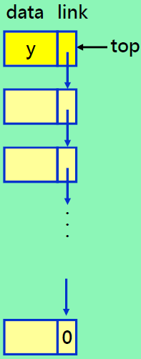
Linked Stack Operations
template <class T>
void LinkedStack <T>::Push(const T& e) {
top = new ChainNode <T>(e, top);
}
template <class T>
void LinkStack <T>::Pop( )
{// Delete top node from the stack
if (IsEmpty())
throw “Stack is empty. Cannot delete.”;
ChainNode <T> *delNode = top;
top = top->link; // remove top node
delete delNode; // free the node
}

Slide 113
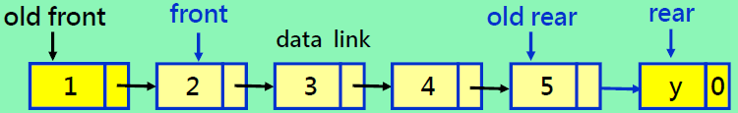
Linked Queue Operations
template <class T>
void LinkedQueue <T>::Push(const T& e){
if (IsEmpty( )) front = rear = new ChainNode(e,0);
else rear = rear->link = new ChainNode(e,0);
//attach node and update rear
}
template <class T>
void LinkedQueue <T>::Pop()
{ // Delete first element in queue
if (IsEmpty()) throw “Queue is empty. Cannot delete.”;
ChainNode<T> *delNode = front;
front = front->link; // remove first node from chain
delete delNode;
}

Slide 114
Outline
4.1 Singly Linked Lists & Chains
4.2 Representing Chains in C++
4.3 The Template Class Chain
4.4-4.5 Circular Lists & Available Space Lists
4.6 Linked Stacks & Queues
4.7 Polynomials,
4.8 Equivalent Classes
4.9 Sparse Matrices
4.10 Doubly Linked Lists
4.11 Generalized Lists

Slide 115
Linked Polynomials
We can have Polynomials that IS-IMPLEMENTED-IN-TERMS-OF Lists (instead of arrays)
Definition of IS-IMPLEMENTED-IN-TERMS-OF
A data object of Type A IS-IMPLEMENTED-IN-TERMS-OF a data object of Type B if the Type B object is central to the implementation of the Type A object
This relationship is usually expressed by declaring the Type B object as a data member of the Type A object
Polynomial IS-IMPLEMENTED-IN-TERMS-OF linked list

Slide 116
Polynomial Classes
struct Term {
int coef;
int exp;
Term Set(int c, int e) { coef=c; exp=e; return *this; }
};
class Polynomial{
public:
// Polynomial operations
private:
Chain<Term> poly;
}
a.poly.first
3
14
2
8
1
0
0
a = 3x¹⁴ + 2x⁸ + 1
Term
link
b.poly.first
8
14
-3
10
10
6
0
b = 8x¹⁴ - 3x¹⁰ + 10x⁶

Slide 117
Adding Polynomials
3x¹⁴ + 2x⁸ + 1
+
8x¹⁴ + -3x¹⁰ + 10x⁶
11x¹⁴ + -3x¹⁰ + 2x⁸+ 10x⁶ + 1
1
3
5
3
14
2
8
1
0
0
8
14
-3
10
10
6
0
1
2
4

Slide 118
Polynomial Polynomial::operator+(const Polynomial& b) const
{
Term temp;
Chain <Term>::ChainIterator ai = poly.begin(), bi = b.poly.begin();
Polynomial c;
while (ai && bi) {
if (ai->exp == bi->exp) {
int sum = ai->coef + bi->coef;
if (sum) c.poly.InsetBack (temp.Set(sum, ai->exp));
ai++; bi++;
} else if (ai->exp < bi->exp) {
c.poly.InsertBack(temp.Set(bi->coef, bi->exp)) ;
bi++;
} else {
c.poly.InsertBack(temp.Set(ai->coef , ai->exp)) ;
ai++;
}
}
while (ai)
{ c.poly.InsertBack(temp.Set(ai->coef,ai->exp)); ai++; }
while (bi)
{ c.poly.InsertBack (temp.Set(bi->coef,bi->exp)); bi++; }
return c;
}

Slide 119
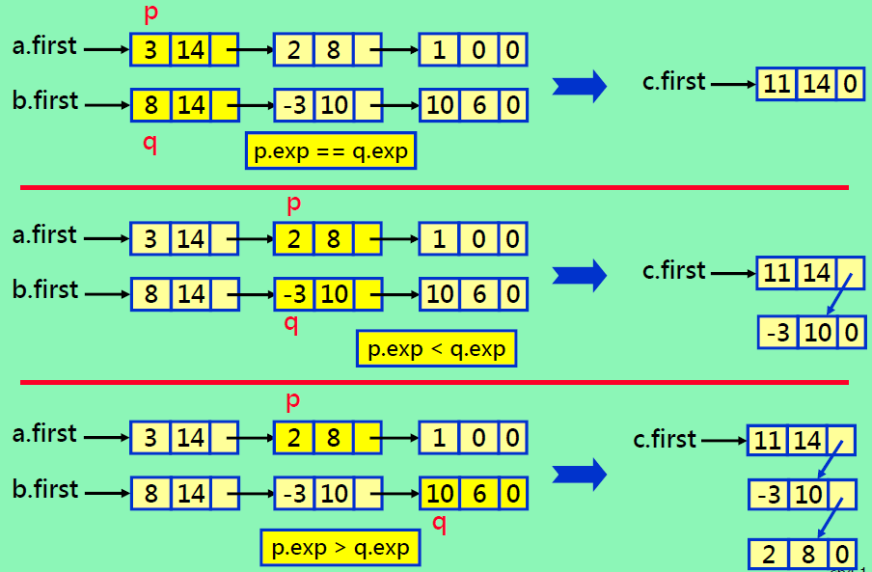
Generating The First Three Terms

Slide 120
Analysis of Operator+
Computing Time
(1) coefficient additions
(2) exponent comparisons
(3) addition/deletions to available space
(4) creation of new nodes
Assume that
polynomial a has m terms, while b has n terms
Coefficient additions: [ 0, min{m, n} ] times
Lower-bound: when none of the exponents are equal
Upper-bound: when the exponents of one polynomial are a subset of the exponents of the other polynomial
Overall Complexity: O(m+n)

Slide 121
Example: Polynomial Computation
d(x) = a(x) * b(x) + c(x)
void func()
{
Polynomial a, b, c, d, t;
cin >> a; // read and create polynomial
cin >> b;
cin >> c;
t = a * b;
d = t + c;
cout << d;
}
Problems: When the function terminates, the memory occupied by the polynomials a, b, c, d, t may not be freed automatically because ChainNode<Term> objects are not physically contained in Chain<Term> objects.

Slide 122
Solution
By incorporating Circular List
Freeing all the nodes in a list is more efficient – CircularList<T>::~CircularList() for clearing a list
Reuse strategy: Available Space List
Deletion: nodes that have been “deleted” are actually maintained in a pool available (av) space
CircularList<T>::RetNode(ChainNode<T>*& x)
Request for a new node:
(1) If available space is not empty, recycle one of them
(2) If available space is empty by “new” command
CircularList<T>::RetNode(ChainNode<T>*& x)

Slide 123
Outline
4.1 Singly Linked Lists & Chains
4.2 Representing Chains in C++
4.3 The Template Class Chain
4.4-4.5 Circular Lists & Available Space Lists
4.6 Linked Stacks & Queues
4.7 Polynomials,
4.8 Equivalent Classes
4.9 Sparse Matrices
4.10 Doubly Linked Lists
4.11 Generalized Lists

Slide 124
Equivalence Relation
A relation is a set of pair (x, y)
where x and y are elements in a set, say S
Three properties of an equivalence relation
Reflexive: x ≡ x
Symmetric: If x ≡ y, then y ≡ x
Transitive: If x ≡ y and y ≡ z then x ≡ z
Definition
A relation over a set S, is said to be an equivalence relation over S iff it is symmetric, reflexive, and transitive over S.
E.g., “equal to” (=) relationship is an equivalence relation

Slide 125
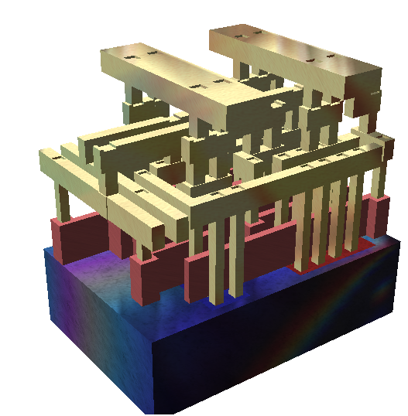
Equivalence Class Problem
Integrated circuit (IC) fabrication involves exposing a silicon wafer using a series of masks (光罩)
Each mask consists of several polygons that define metal lines
Connected lines form power/signal net
…
masks
…
…
silicon
http://en.wikipedia.org/wiki/Standard_cell

Slide 126
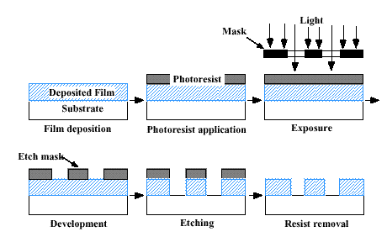
Basic IC Fabrication Procedure
(Supplementary information)
The Fabrication of Integrated Circuits
https://www.youtube.com/watch?v=35jWSQXku74
http://www.hitequest.com/Kiss/VLSI.htm

Slide 127
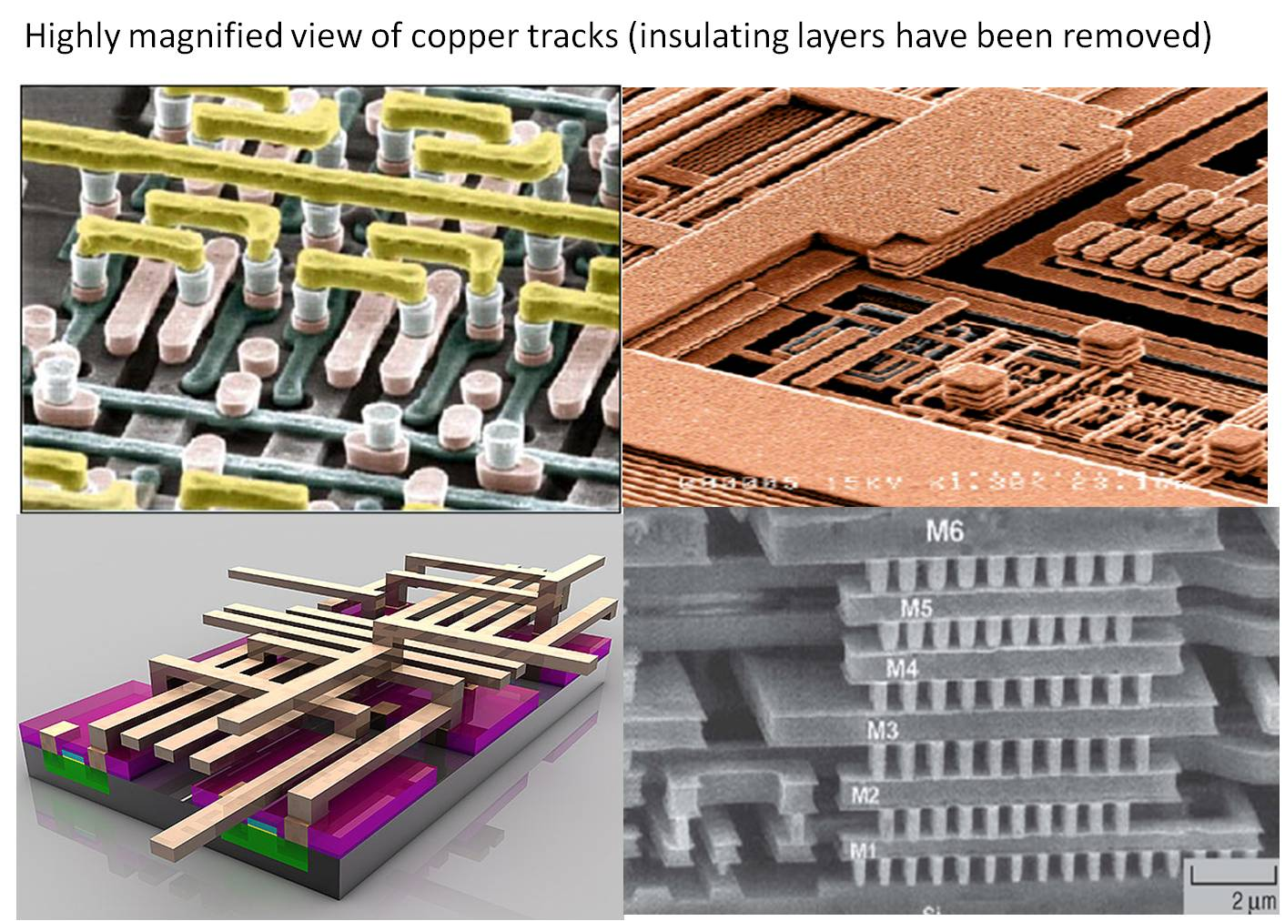
Gallery
(Supplementary information)
state of the art has a 0.02 μm line pitch
http://www.cense.iisc.ernet.in/nanotwiki.html

Slide 128
Equivalence Class Problem
We are given polygons and overlap/equivalence pairs (denoted by '≡') among polygons
We want to partition the polygons into equivalence classes
For example
Input: 0 ≡ 4, 3 ≡ 1, 6 ≡ 10, 8 ≡ 9, 7 ≡ 4, 6 ≡ 8, 3 ≡ 5, 2 ≡ 11, and 11 ≡ 0
Output: {0, 2, 4, 7, 11}; {1, 3, 5}; {6, 8, 9, 10}

Slide 129
Properties of Equivalence Relation
'≡' is reflexive
For any polygon x, x ≡ x
'≡' is symmetric
For any two polygons x and y, if x ≡ y, then y ≡ x
'≡' is transitive
For any three polygons x, y, and z, if x ≡ y and y ≡ z, then x ≡ z

Slide 130
Algorithm
Phase 1
Read and store all equivalence pairs (i, j)
Phase 2
Begin at polygon 0 and find all pairs of the form (0, j)
0 and these j's are of the same class
Find all pairs of the form (j, k)
By transitivity, k is in the same class as 0 and j
Continue in this way until the entire equivalence class containing 0 has been found and output
Find an object not yet output, which is in a new equivalence class
Find and output the new equivalence class as before

Slide 131
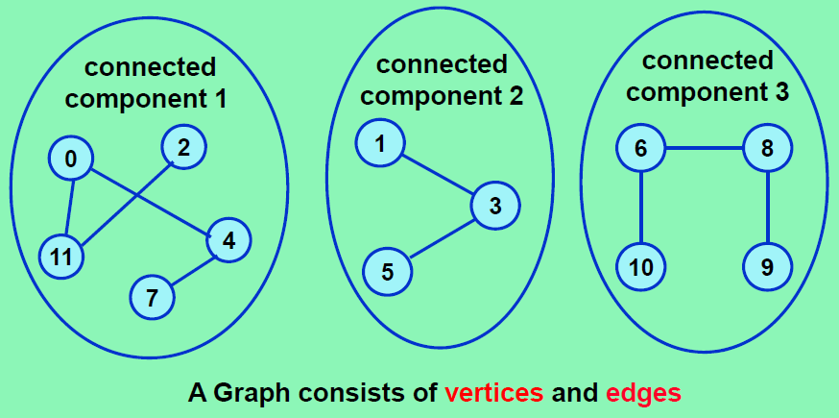
Relation Graph
Input
0≡4, 3≡1, 6≡10, 8≡9, 7≡4, 6≡8, 3≡5, 2≡11, 11≡0

Slide 132
Data Structure Design Decision
For storing all equivalence pairs (i, j)
n×n array
e.g., bool pairs[n][n]
Result in Θ(n²) time complexity
Chain representation
n-element array, e.g., bool out[n], is used for recording whether objects are output
0 ≡ 4, 3 ≡ 1, 6 ≡ 10, 8 ≡ 9, 7 ≡ 4, 6 ≡ 8, 3 ≡ 5, 2 ≡ 11, 11 ≡ 0

Slide 133
Example
out
first
(Begin at 0) (Add 0 into a container, e.g., a stack)
(Get 0 from the container) Output 0 (Add 11 and 4 into the stack)
(Get 4 from the container) Output 4 (Add 7 into the stack)
(Get 7 from the container) Output 7 (No new objects are found)
(Get 11 from the container) Output 11 (Add 2 into the stack)
(Get 2 from the container) Output 2 (No new objects found)

Slide 134
Algorithm in C++
void Equivalence( )
{
ifstream inFile("equiv.in", ios::in);
if (!inFile) throw “Cannot open input file.”;
int i, j, n;
inFile >> n; // number of objects
// initialize first and out
bool *out = new bool[n]; // an array of bool
ENode **first = new ENode* [n]; // an array of pointers
// use STL function fill to initialize
fill (first, first + n, 0);
fill (out, out + n, false);
// Phase 1: input equivalence pairs
inFile >> i >> j;
while (inFile.good()) { //check end of file
first[i] = new ENode (j, first[i])
first[j] = new ENode (i, first[j])
inFile >> i >> j;
}

Slide 135
for (i = 0; i < n; i++) // Phase 2
if (!out[i]) { // this object has not been output yet
cout << endl << "A new class: " << i;
out[i] = true; // mark the object
stack<Enode> s; // initialize a stack
ENode *x = first[i]; // obtain the i^{th} list
while (1) { // continue processing lists and the stack
while (x) { // continue processing a list
j = x->data;
if (!out[j]) {
cout << ", " << j;
out[j] = true;
s.push(*x); // add *x into the stack
}else{
x = x->link;
}
} // end of while(x)
if (s.isEmpty()) break;
x = first[s.top().data];
s.pop(); // unstack
} // end of while(1)
} // end of if (!out[i])

Slide 136
Algorithm in C++ (cont'd)
for (i = 0; i < n; i++) // clean up Phase-1-created objected
while (first[i]) {
ENode *delnode = first[i];
first[i] = delnode->link;
delete delnode;
}
delete [] first;
delete [] out;
Time complexity = O(m+n)
Initialization of first[] and out[] takes O(n) time
where n is the number of objects
Processing of each input pair in phase takes O(m)
where m is the number of input pairs
The for loop takes O(n) time
Evaluating of the 2m pairs takes O(m) time

Slide 137
Outline
4.1 Singly Linked Lists & Chains
4.2 Representing Chains in C++
4.3 The Template Class Chain
4.4-4.5 Circular Lists & Available Space Lists
4.6 Linked Stacks & Queues
4.7 Polynomials,
4.8 Equivalent Classes
4.9 Sparse Matrices
4.10 Doubly Linked Lists
4.11 Generalized Lists

Slide 138
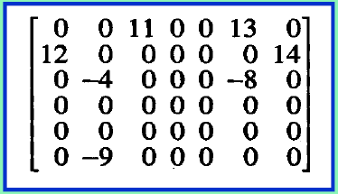
Sparse Matrix As A Two-Dimensional Linked List
7 nonzero terms
Two-Dimensional Linked List – easy access by row and column
row, col – header nodes list for row and column
Matrix term: row-circular list (right), col-circular list (down)
next
row
col
value
down
right
down
right
header node
element node

Slide 139
Sparse Matrices
Array-based representation (we have learned this before)
Row access is easy, but column access is difficult
Linked representation
Easy access both by row and column
Node design (head field will not be shown later)
Handler
Terms
Row/Col Head
#row
#col
#terms
row
col
val
next
down
right
down
right
down
right
ishead
ishead
ishead
ishead = false
ishead = true

Slide 140
Linked Sparse Matrix
H0
H1
H2
H3
H4
H
5
4
6
H0
0
0
2
H1
1
0
4
1
3
3
H2
H3
3
0
8
3
3
1
H4
4
2
6

Slide 141
Figure Explanations
H
H0
H
H0
4
5
6
4
5
6
≡
H0
0
0
2
0
0
2
H
H0
(in memory)
4
5
6
…
4
5
6
&H0
&H0
&T
&T
≡
…
&T
&T
0
0
2
T
…
&H0
0
0
2
&H0

Slide 142
Sparse Matrix Definition
struct Triple{
int row, col, value;
};
class Matrix; // forward declaration
class MatrixNode {
friend class Matrix;
friend istream& operator>>(istream&, Matrix&);
// for reading in a matrix
private:
MatrixNode *down , *right;
bool head;
union {
MatrixNode *next;
Triple triple;
};
MatrixNode(bool, Triple*); // constructor
};
// union allow multiple objects to
// overlap with one another.
// Programmers are responsible to
// take care the use of them.

Slide 143
Sparse Matrix Definition
MatrixNode::MatrixNode(bool b, Triple *t) // constructor
{
head = b;
if (b) {// row/column header node
right = down = this;
}else{
triple = *t; // element node
}
}
class Matrix{
friend istream& operator>>(istream&, Matrix&);
public:
~Matrix(); // destructor
private:
MatrixNode *headnode;
};

Slide 144
Sparse Matrix Input
Overloading the >> operator makes sparse matrix more like built-in types
Matrix m;
cin >> m;
inputs
4 5 6
0 0 2
1 0 4
1 3 3
3 0 8
3 3 1
4 2 6

Slide 145
istream object
“cin” is an istream object
This statement is the same as ((cin >> m) >> n) >> k;
Each >> operator receives two input arguments: ifstream and Matrix
Each >> operator produces an ifstream output that is the same as the input ifstream
#include <iostream>
using namespace std;
int main()
{
Matrix m, n, k;
cin >> m >> n >> k;
}

Slide 146
Sparse Matrix Input
istream& operator>>(istream& is, Matrix& matrix)
{// Read in a maxtix and set up its linked representation
Triple s;
is >> s.row >> s.col >> s.value; // matrix dimensions
int p = max(s.row, s.col);
// set up header node for list of header nodes
matrix.headnode = new MatrixNode(false, &s);
if (p == 0) {
matrix.headnode->right = matrix.headnode;
return is; // for supporting "cin >> mi >> mj;"
}
// at least one row or column
MatrixNode **head = new MatrixNode* [p];
for (int i = 0; i < p; i++)
head[i] = new MatrixNode(true, 0);
// please continue on the next page
5
0
0

Slide 147
Sparse Matrix Input
int currentRow = 0;
int MatrixNode *last = head[0]; // last node in current row
for (i = 0; i < s.value; i++) // input triples
{
Triple t;
is >> t.row >> t.col >> t.value;
if (t.row > currentRow) { // end of current row
last->right = head[currentRow]; // close current row
currentRow = t.row;
last = head[currentRow];
} // end of if
last = last->right = new MatrixNode(false, &t);
// link new node into row list
head[t.col]->next = head[t.col]->next->down = last;
// link into column list
} // end of for
// please continue on the next page
last
last
new

Slide 148
Sparse Matrix Input
last->right = head[currentRow]; // close last row
for (i = 0; i < s.col; i++)
head[i]->next->down = head[i] // close all column lists
// link the header nodes together
for (i = 0; i < p; i++)
head[i]->next = head[i + 1];
head[p-1]->next = matrix.headnode;
matrix.headnode->right = head[0];
delete [] head;
return is;
}

Slide 149
Sparse Matrix Deletion
Matrix::~Matrix()
{// Return all nodes to the av list, which is a chain linked
// via the right field.
// av is a static variable pointing to the first of the av list.
if (!headnode )
return; // no nodes to delete
MatrixNode *x = headnode->right;
headnode->right = av;
av = headnode; // return headnode
while (x != headnode) { // return nodes by rows
MatrixNode *y = x->right;
x->right = av;
av = y;
x = x->next; // next row
}
headnode = 0;
}

Slide 150
Outline
4.1 Singly Linked Lists & Chains
4.2 Representing Chains in C++
4.3 The Template Class Chain
4.4-4.5 Circular Lists & Available Space Lists
4.6 Linked Stacks & Queues
4.7 Polynomials,
4.8 Equivalent Classes
4.9 Sparse Matrices
4.10 Doubly Linked Lists
4.11 Generalized Lists

Slide 151
Doubly Linking vs. Singly Linking
Doubly linked
Each node contain pointers to the both direction
Traversal can be performed in both direction
Singly linked
Traversal can only be performed in one direction
left
data
right
(prev)
(next)

Slide 152
Circular, Doubly Linked Lists with Header
Empty list
Non-empty list
first
header node
first
header

Slide 153
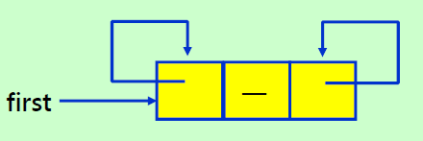
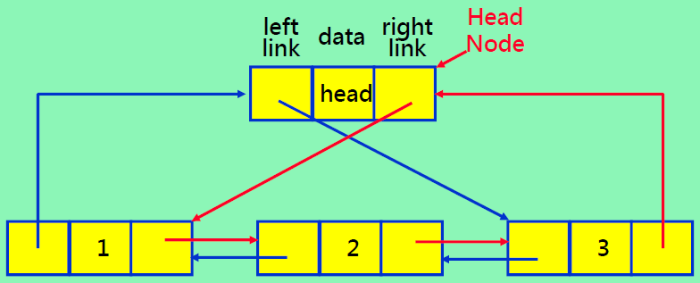
Doubly Circular Linked Lists with Header
Empty list
Non-empty list

Slide 154
Doubly Linked List Definition
class DblList; //forward declaration
class DblListNode {
friend class DblList;
private:
int data;
DblListNode * left, * right;
};
class DblList {
public:
// List manipuation operations
.
.
private:
DblListNode *head; // points to header node
};
Please note the syntax for declaring two pointers a line

Slide 155
Insertion Operation
void DblList :: Insert(DblListNode *p, DblListNode *x)
{ // insert node p to the right of node x
p->left = x;
p->right = x->right;
x->right->left = p;
x->right = p;
}
1
2
3
4
head
1
2
4
3
x
p

Slide 156
Deletion Operation
void DblList :: Delete(DblListNode *x)
{
if (x == head)
throw "Deletion of header node not permitted";
else {
x->left->right = x->right;
x->right->left = x->left;
delete x;
}
}
1
2
1
head
2
x

Slide 157
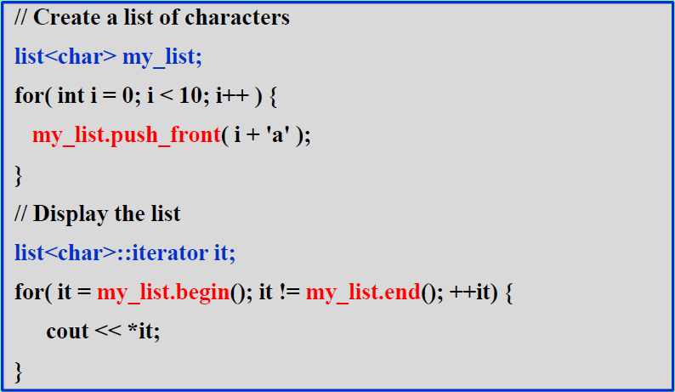
Using List Iterator in STL
C++ reference 網頁: http://www.cppreference.com/wiki/start
STL 網頁: http://www.cppreference.com/wiki/stl/start
STL List 網頁: http://www.cppreference.com/wiki/stl/list/start

Slide 158
Outline
4.1 Singly Linked Lists & Chains
4.2 Representing Chains in C++
4.3 The Template Class Chain
4.4-4.5 Circular Lists & Available Space Lists
4.6 Linked Stacks & Queues
4.7 Polynomials,
4.8 Equivalent Classes
4.9 Sparse Matrices
4.10 Doubly Linked Lists
4.11 Generalized Lists

Slide 159
Generalized Lists
Definition
A generalized list, A, is a finite sequence of n≧0 elements, (α₀, …, α_{n-1}) where element α_{i} is either an atom or a list.
The elements α_{i} , 0 ≤ i ≤ n-1, that are not atoms are said to be the sublists
Head
α₀ is called the head of A
Tail
(α₁, …, α_{n-1}) is called the tail of A
• This is a recursive definition
E.g., C=(a, C)=(a, (a, (a, …))), A=(a, (b, c)), B=(A, A, ())
A compact way of describing a large and varied structure

Slide 160
Exampling Generalized Lists
A = ()
Empty (also referred to as null) list
Length is zero
B = (a, (b, c))
Length is two
First element is the atom a (head(B) = ‘a’)
Second element is the linear list (b, c) (tail(B) = ((b,c))
C = (B, B, ())
Length is three
First two elements are the list B
Third element is the empty (null) list
D = (a, D)
Recursive list of length two
Corresponds to the infinite list (a, (a, (a, …)))

Slide 161
Exampling Generalized Lists
A = ()
B = (a, (b, c))
C = (B, B, ())
D = (a, D)
head(B) = a
tail(B) = ((b, c))
head( tail(B) ) = (b, c)
tail( tail(B) ) = ()
head(C) = B
tail(C) = (B, ()), head(tail(C)) = B, tail(tail(C)) = (())
Lists may be shared by other lists, e.g., list B makes up two of the sublists of C
List may be recursive

Slide 162
Generalized-List Polynomials
Polynomial With Multiple Variables
Example
P(x,y,z) = x¹⁰y³z² + 2x⁸y³z² + 3x⁸y²z² + x⁴y⁴z + 6x³y⁴z + 2yz
Factorizing out variables
P(x,y,z) = x¹⁰y³z² + 2x⁸y³z² + 3x⁸y²z² + x⁴y⁴z + 6x³y⁴z + 2yz
= (x¹⁰y³ + 2x⁸y³ + 3x⁸y²)z² + (x⁴y⁴+6x3y⁴+2y)z
= ((x¹⁰ + 2x⁸)y³ + 3x⁸y²)z² + ((x⁴ + 6x³)y⁴ + 2y)z
=
Every polynomial consists of a variable plus coefficient-exponent pairs.
C(x, y)z² + D(x, y)z
=
=
E(x)y³ + F(x)y²
G(x)y⁴ + G(x)y

Slide 163
Generalized-List Polynomials
((x¹⁰ + 2x⁸)y³ + 3x⁸y²)z² + ((x⁴ + 6x³)y⁴ + 2y)z
Three types of information
Factored-out variable
Exponent of the factored variable and a link to the associated sub-polynomial
Coefficient of each term
Node structure for storing the information
e.g., 'z'
e.g., 2
(x¹⁰ + 2x⁸)y³ + 3x⁸y²
e.g., 1
type of the node
variable name / link to sub-polynomial / coefficient
exponent (optional)
link to the next node

Slide 164
Node Definition
enum NodeType{var, ptr, no}; // var=0, ptr=1, no=2
class PolyNode
{
NodeType type;
char name;
PolyNode* sub;
int coef;
int exp;
PolyNode* next; // link to next node
}
type of the node
variable name
link to sub-polynomial
coefficient
exponent (optional)
link to the next node

Slide 165
Node Definition
enum NodeType{var, ptr, no}; // var=0, ptr=1, no=2
class PolyNode
{
NodeType type;
union{
char name;
PolyNode* sub;
int coef;
}
int exp;
PolyNode* next; // link to next node
}
// three variables overlap in memory
type of the node
name / sub / coef
exponent (optional)
reduced node size
link to the next node

Slide 166
PolyNode Class
enum Triple{var, ptr, no};
class PolyNode
{
Triple trio;
union {
char vble;
PolyNode *down; //link field
int coef;
};
int exp;
PolyNode *next; //link field
};
trio
union
exp
next
trio=
var: the node is the header node, vble is name of variable
ptr: the coefficient is itself a list pointed by down
no: coefficient is integer stored in the field coef
多項式3x²y的表示法

Slide 167
Generalized-List Polynomials
((x¹⁰ + 2x⁸)y³ + 3x⁸y²)z² + ((x⁴ + 6x³)y⁴ + 2y)z
3x⁸
x
0
3
8
0
x¹⁰+2x⁸
x
0
1
10
2
8
0
For simplicity, trio field is omitted.

Slide 168
Generalized-List Polynomials
((x¹⁰ + 2x⁸)y³ + 3x⁸y²)z² + ((x⁴ + 6x³)y⁴ + 2y)z
y
0
3
2
0
y³(…) + y²(…)
3x⁸
x
0
3
8
0
x¹⁰+2x⁸
x
0
1
10
2
8
0
For simplicity, trio field is omitted.

Slide 169
Generalized-List Polynomials
((x¹⁰ + 2x⁸)y³ + 3x⁸y²)z² + ((x⁴ + 6x³)y⁴ + 2y)z
y
0
3
2
0
y
0
4
1
0
y³(…) + y²(…)
3x⁸
x
0
3
8
0
x
0
2
0
0
x¹⁰+2x⁸
x
0
1
10
2
8
0
x
0
1
4
6
3
0
For simplicity, trio field is omitted.

Slide 170
Generalized-List Polynomials
((x¹⁰ + 2x⁸)y³ + 3x⁸y²)z² + ((x⁴ + 6x³)y⁴ + 2y)z
z
0
2
1
0
z²(…) + z(…)
y
0
3
2
0
y
0
4
1
0
y³(…) + y²(…)
3x⁸
x
0
3
8
0
x
0
2
0
0
x¹⁰+2x⁸
x
0
1
10
2
8
0
x
0
1
4
6
3
0
For simplicity, trio field is omitted.

Slide 171
Generalized Lists
Every generalized list can be represented using the node structure shown below:
Node structure
tag = F/T
data / down
next
tag = F: data/down field holds an atom if head(A) is an atom
tag = T: data/down field holds a pointer to the list representation of head(A) if head(A) is a list.

Slide 172
Generalized List Definition
template <class T> class GenList; // forward declaration
template <class T>
class GenListNode{
friend class GenList <T>;
private:
bool tag;
union {
T data;
GenListNode<T>* down;
};
GenListNode<T>* next;
};
template <class T>
class GenList{
public:
// List manipulation operations
private:
GenListNode<T>* first;
};

Slide 173
Generalized Lists Examples
A = ()
A' = (())
B = (a, (b, c))
C = (B, B, ())
D = (a, D)
A = ()
A' = (())
A.first
0
A'.first
T
0
0
B.first
F
a
T
0
B = (a, (b, c))
F
b
F
c
0
C.first
T
T
T
0
0
C = (B, B, ())
D.first
F
a
T
0
D = (a, D)

Slide 174
Recursive Algorithms
For recursively defined data object
It is often easy to describe algorithms that work on these objects recursively
Two components in a recursive operation
(1) workhorse: the recursive function itself
Often declared as a private member function
(2) driver: the function that invokes the recursive function at the top level
Declared as a public member function

Slide 175

Copying a Nonrecursive List
// Driver
void GenList<T>::Copy(const GenList<T>& l)
{ // make a copy of l
first = Copy (l.first);
}
// Workhorse
GenListNode<T>* GenList<T>::Copy(GenListNode<T>* p)
{// Copy the nonrecursive list with no shared sublists
GenListNode<T>*q = 0;
if (p) {
q = new GenListNode<T>;
q->tag = p->tag;
if (p->tag) q->down = Copy (p->down);
else q->data = p->data;
q->next = Copy(p->next);
}
return q;
}

Slide 176
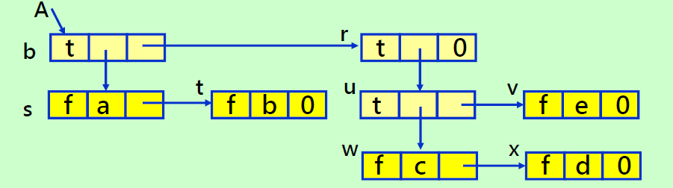
Example: General List Copy
A = ((a,b),((c,d),e))
Level of recursion | value of p | Continuing level | p | Continuing level | p
1 | b | 2 | r | 3 | u
2 | s | 3 | u | 4 | v
3 | t | 4 | w | 5 | 0
4 | 0 | 5 | x | 4 | v
3 | t | 6 | 0 | 3 | u
2 | s | 5 | x | 2 | r
1 | b | 4 | w | 3 | 0
 |  |  |  | 2 | r
 |  |  |  | 1 | b

Slide 177
List Equality
Another useful function determines whether two lists are identical.
To be identical, the lists must have the same structure and the same data in corresponding data members.
Use the recursive definition of a list to accomplish equality operator overload
The computing time is clearly no more than linear when no sublists are shared, since it looks at each node of the two lists being compared no more than three times.

Slide 178
Testing Equality for Two Lists
// Driver
template<class T>
bool operator == (const GenList<T>& l) const
{// *this and l are non-recursive lists
// return true iff the two lists are identical
return Equal (first, l.first);
}
// Workhorse
bool Equal(GenListNode<T>*s, GenListNode<T>*t)
{
if ((!s) && (!t)) return true;
if (s && t && (s->tag == t->tag))
if (s->tag)
return Equal(s->down,t->down) && Equal(s->next, t->next);
else
return (s->data == t->data) && Equal(s->next, t->next);
return false;
}

Slide 179
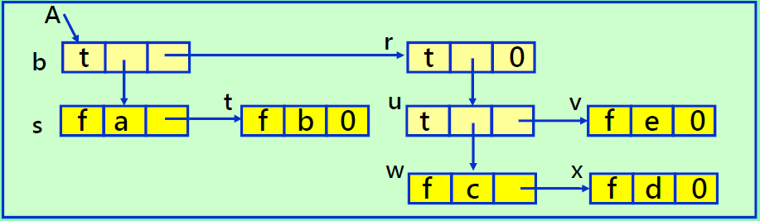
Example: Depth of General List
A = ((a,b),((c,d),e))
A has two sub-lists: b→dlink and r→dlink
Depth of list pointed by b→dlink: 1
Depth of list pointed by r→dlink: 2
Depth(A) = 1 + max( Depth(b), Depth(r) ) = 3

Slide 180
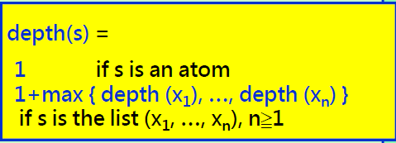
Computing the List Depth
// Driver
template <class T>
int GenList<T>::Depth()
{ // Compute the depth of a non-recursive list
return Depth(first);
}
// Workhorse
template <class T>
int GenList::Depth(GenListNode<T>* s)
{
if (!s) return 0; // empty list
GenListNode<T>* current = s;
int m=0; // initial minimum value
while (current) {
if (current->tag) m = max(m, Depth(current->down));
current = current->next;
} // m is the max depth among sublists
return m+1;
}
// Depth ≡ max degree of nested sublists

Slide 181
Computing the List Depth
3
B.first
F
a
T
0
…
T
0
2
1
represents an instance of Depth()
F
T
F
0
F
F
0
represents function invocation and return
1
F
F
0
return value is in red
template <class T>
int GenList::Depth(GenListNode<T>* s)
{
if (!s) return 0; // empty list
GenListNode<T>* current = s;
int m=0;
while (current) {
if (current->tag) m = max(m, Depth(current->down));
current = current->next;
} // m is the max depth among sublists (m=0 if no sublists exist)
return m+1; // increments m for the current list
}

Slide 182
Adding a Node or Deleting a Lists
Design issues (when lists sharing permitted)
Adding or deleting node at the front of a list can affect the down fields of other lists
e.g., adding an 'x' in front of 'a' in B (B is shared by C)
We normally do not know these affected fields
Determining whether list nodes need to be freed
e.g., the node 'a' needs to be kept (if other lists require it) even if B.first no longer points to it
B = (a, (b, c))
B.first
F
a
T
0
F
b
F
c
0
C = (B, B, ())
C.first
T
T
T
0
0

Slide 183
Generalized Lists Examples
A = ()
A' = (())
B = (a, (b, c))
C = (B, B, ())
D = (a, D)
A = ()
A' = (())
A.first
0
A'.first
T
0
0
B.first
F
a
T
0
B = (a, (b, c))
F
b
F
c
0
To facilitate specifying shared sublists, allow naming of sublists.
Give sublist a name:
B = (a,(b,c)) = (a,Z(b,c))
Add one more node to denote sublist name
C.first
T
T
T
0
0
C = (B, B, ())
D.first
F
a
T
0
D = (a, D)

Slide 184
Headers and Reference Counts
Each list/sublist equips a header
Adding and deleting node at the front of the list does not affect other lists
Headers serve the reference point of a list
Header tracks the reference count, the number of pointers pointing to the lists
List nodes with no reference to them require being freed
Header nodes prove useful in determining when the nodes of a particular structure may be returned to the storage pool (available list)

Slide 185
Headers and Reference Counts
A = ()
B = (a, (b, c))
C = (B, B, ())
D = (a, D)
A.first
F
1
0
B.first
F
3
F
a
T
0
A.first→ref=1, accessible only via A.first
B.first→ref=3, B.first + 2 ptr from C
C.first→ref=1, accessible only via C.first
D.first→ref=2, accessible via D.first and one ptr from itself
F
1
F
b
F
c
0
C.first
F
1
T
T
T
0
F
1
0
D.first
F
2
F
a
T
0

Slide 186
Generalized List Definition
template <class T>
class GenList; // forward declaration
template <class T>
class GenListNode{
friend class GenList <T>;
private:
int tag; // 0 for data, 1 for down, 2 for ref
union {
T data;
GenListNode<T>* down;
int ref; // reference count
};
GenListNode<T>* next;
};

Slide 187
Headers and Reference Counts
A = ()
B = (a, (b, c))
C = (B, B, ())
D = (a, D)
A.first
2
1
0
B.first
2
3
0
a
1
0
tag = 0 for data,
1 for down,
2 for ref
2
1
0
b
0
c
0
C.first
2
1
1
1
1
0
2
1
0
D.first
2
2
0
a
1
0

Slide 188
Deleting Generalized Lists Recursively
// Driver
template <class T>
GenList<T>::~GenList() // Destructor
{ // Each header node has a reference count
if (first){
Delete(first);
first = 0;
}
}
// Workhorse
void GenList<T>::Delete(GenListNode<T>* x)
{
x->ref--; // decrement reference count of header node
if (!x->ref){
GenListNode<T> *y = x;
while (y->next) // y traverses top level of x
{ y = y->next; if (y->tag == 1) Delete(y->down); }
y->next = av; // attach top-level nodes to av list
av = x;
}
}

Slide 189
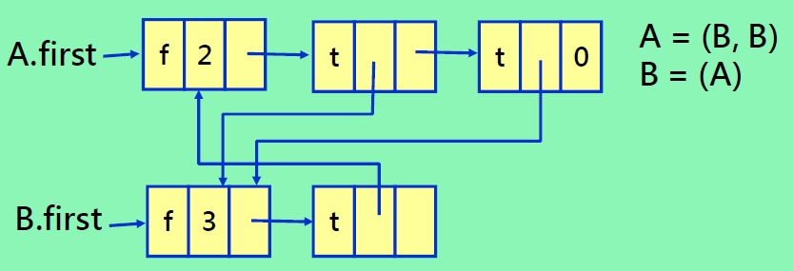
Indirect Recursion Case
For recursive list such as C = (a, C)
The reference count will never be 1
So, they cannot be recycled
Indirect recursive lists cannot be recycled neither
When recursive lists are being used, it is possible to run out of available space, even though not all nodes are in use.

